Slide 1

Using AR/VR for shopping
Group No. 20
Jaaie Kadam 18104017
Prachi Manera 17104013
Project Guide
Prof. Anagha Aher

Slide 2
Contents
Introduction
Objectives
Problem Definition
Technological Stack
Review Suggestions (Given in Last meeting)
Proposed System Architecture/Working
Prototype Design Demonstration
Implementation Status
Status of Paper Draft & Targeted Conference

Slide 3
Introduction
3D Convenience store is a mobile app powered by Virtual Reality to enable advanced shopping experience.
3D Convenience store focuses on bringing a more practical approach to the current shopping system(2D & on-site) using 3D simulation and interaction.
The proposed system introduces a VR based 3D Convenience store where the user can experience Real world based shopping activities Virtually from the Comforts of their home.
This virtual Convenience store will have an easy to interact UI.

Slide 4
Objectives
To advance the current Shopping system by providing user an immersive experience.
To understand the concepts of VR and Unity and develop a prototype using the findings.
To study and implement 3D Modelling and include it in the project.
To create a functional application to cut down the amount of time required to search the products by suggesting relevant items to the user.

Slide 5
Problem Definition
With the 2D shopping websites used today, they have their natural limitations, which is a particularly important element of shopping.
Malls and grocery shops are closed or there are many restrictions imposed on them due to ongoing pandemic.
Customers have to wait in long queues in order to get the tokens increasing the manual work and the amount of time.

Slide 6
Technological Stack
Software Requirements:
• Unity : environment for building, debugging and testing application
Mongodb : for storage
NodeJs : backend
Hardware requirements:
• VR headset and Bluetooth controllers

Slide 7
Review Suggestions
Decide if it is going to be a desktop app or a mobile app
(Using Android store, mobile app will be developed)
Finalize the Products range
(This app will be focusing on all the things available in Grocery Store)
Implement recommendation system

Slide 8
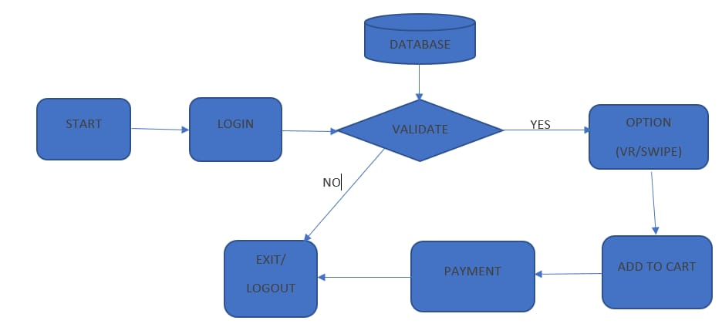
Proposed System Architecture/Working

Slide 9
Prototype Design Demonstration
Input Hardware
(Headset)
USER
Output Hardware
Processing Software
VR Store Simulator
Rendering Engine
Web Admin Panel
Database Web Server
Product Information

Slide 10
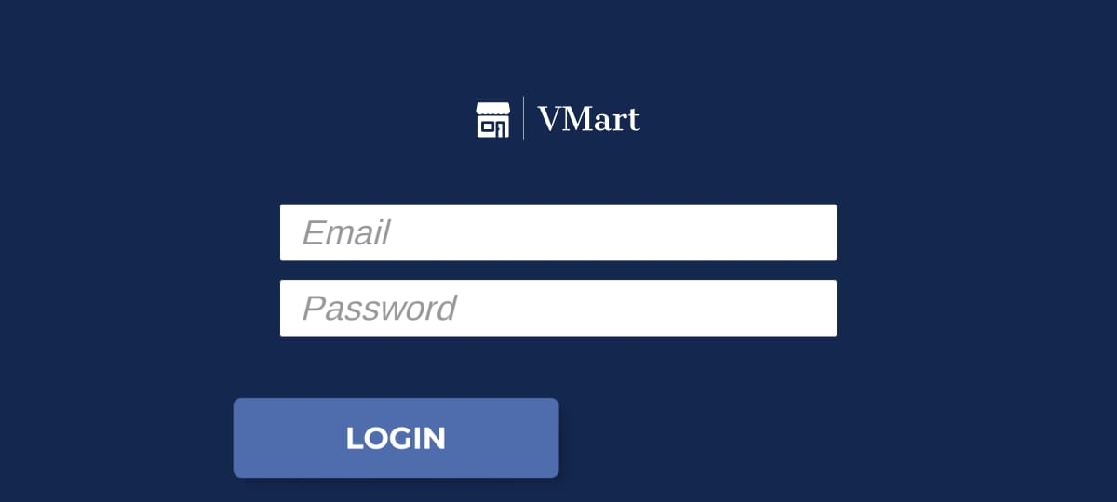
Implementation Status

Slide 11

Implementation Status

Slide 12
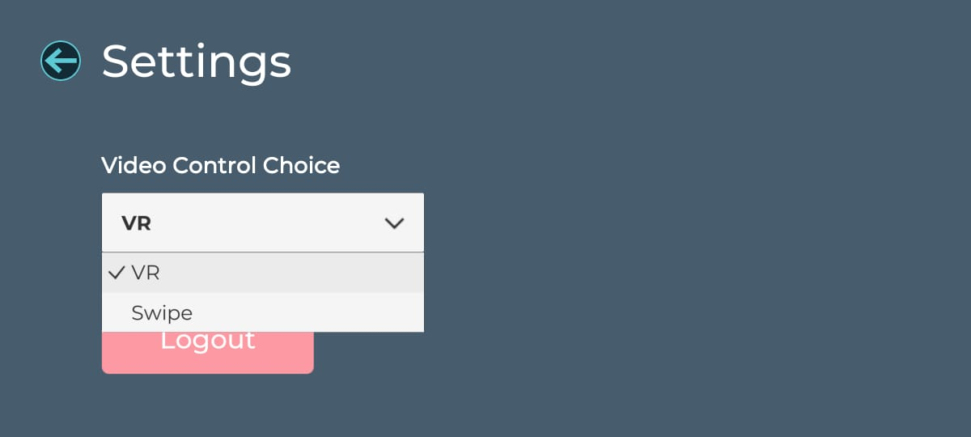
Implementation Status

Slide 13
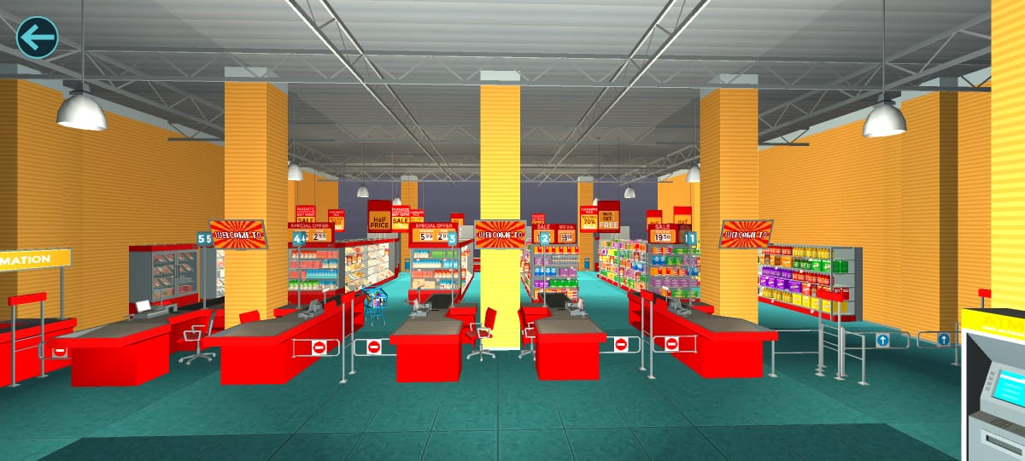
Implementation Status

Slide 14
Status of Paper Draft & Targeted Conference
Conference paper publication submission done.
Targeted Conferences:
IEEE International Conference on Computational Intelligence and Computing Applications-21
https://easychair.org/cfp/IEEEICCICA21
ICCIS 2021 International Conferene on Communication and Intelligent Systems..

Slide 15
Thank You...!!

